Slide 1
Newark vs. Jersey City
SAT business - client possibilities

Slide 2
Description:
I am an SAT tutor, and am starting a business. I want to find out which city is best to start in. I want to see how many schools there are. I will count the number of schools, the more the better. I will also try to narrow it down to type of schools, for instance high schools, not colleges. I like ice cream. Especially McDonald’s Ice Cream. I will see the reviews of McDonalds, and which has more likes.

Slide 3
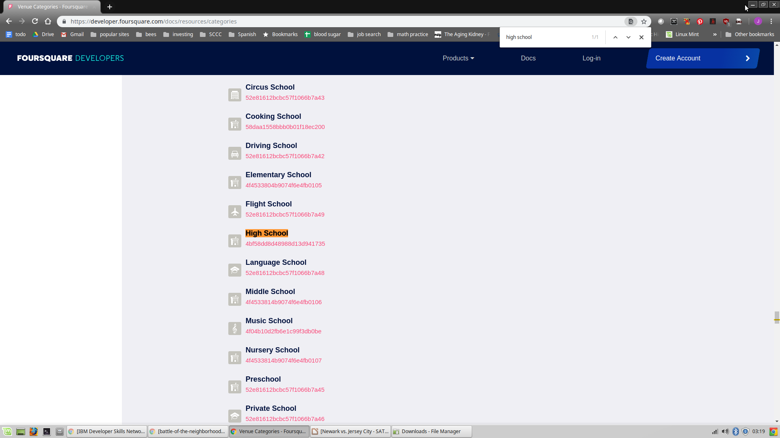
I had to change the search url to include ‘High School’, otherwise all sorts of schools were coming up, and foursquare only returns a max of 50.

Slide 4
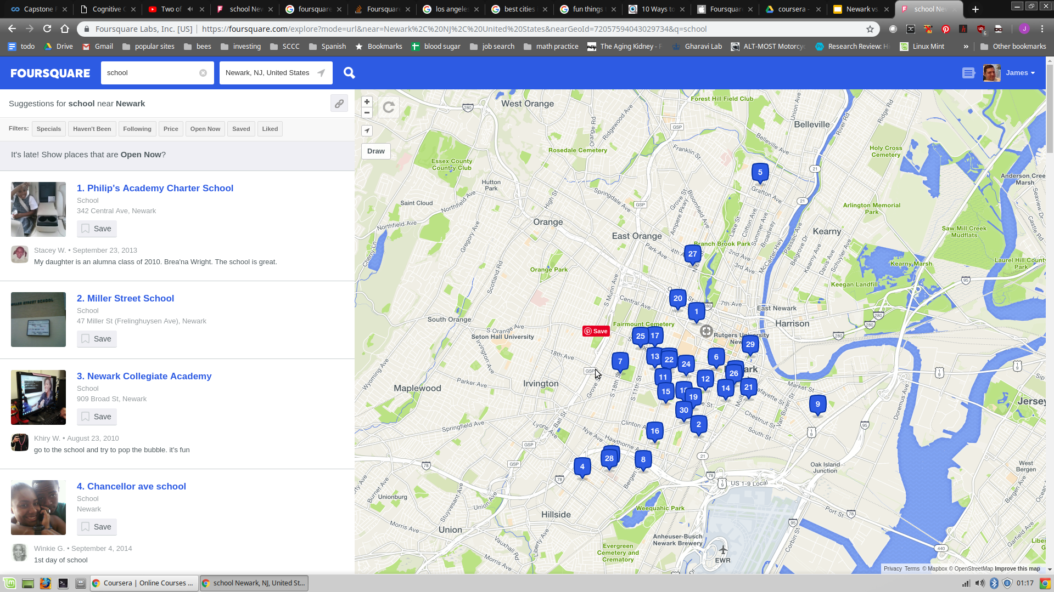
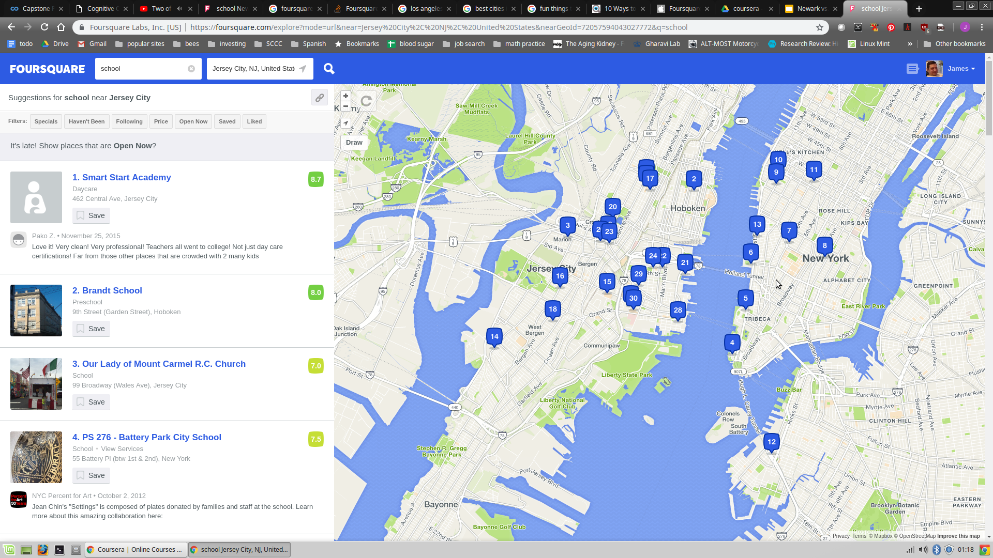

Slide 5
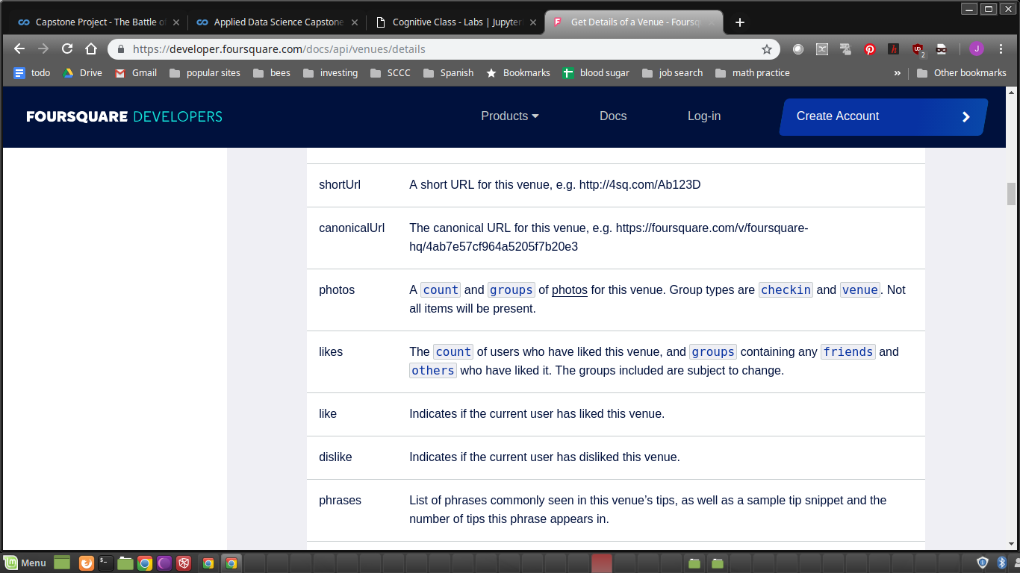
Will also compare likes

Slide 6
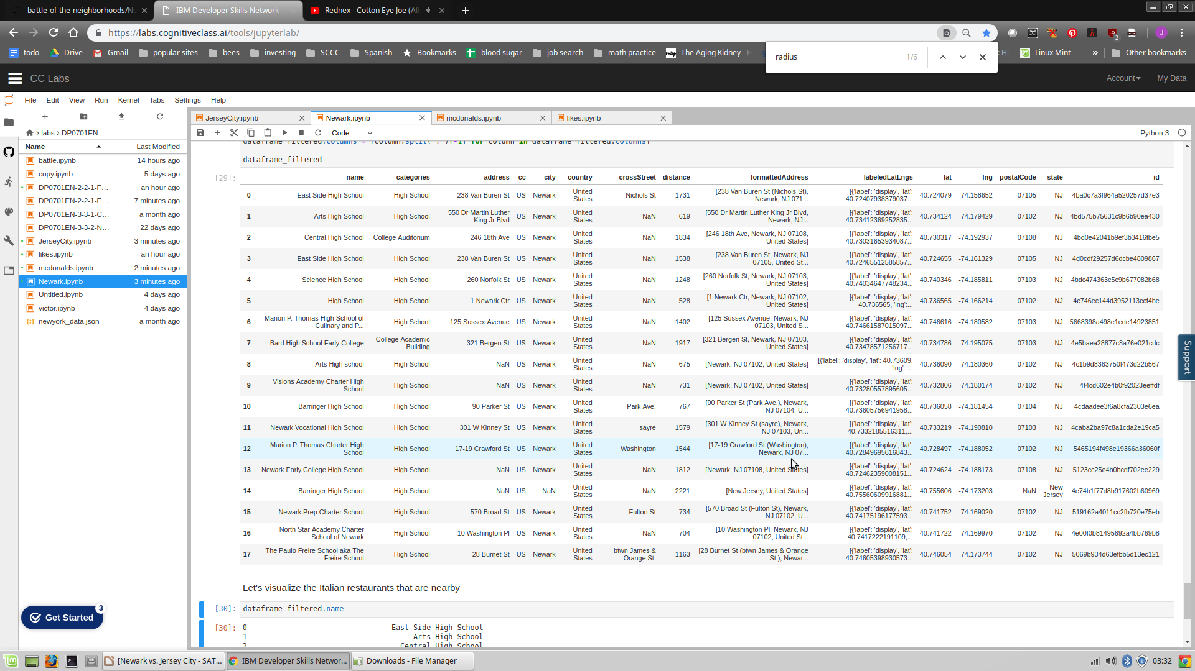
Newark has 18 high schools

Slide 7
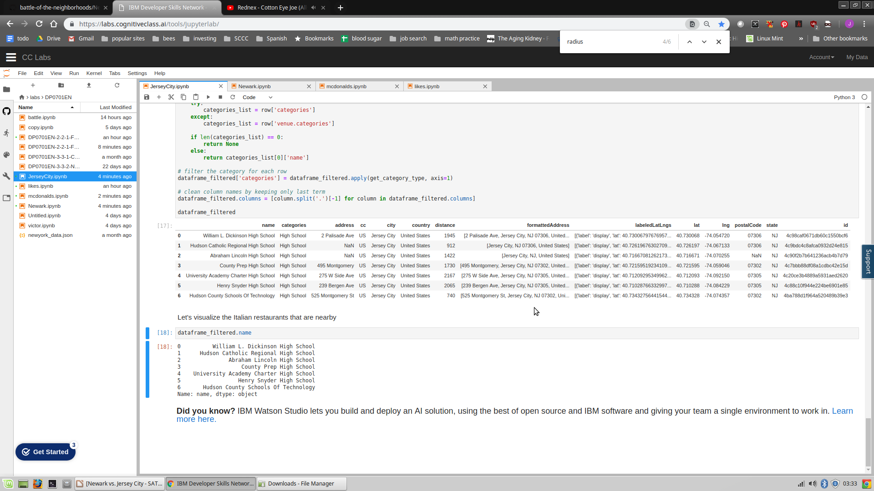
Jersey City has 8

Slide 8
NEWARK WINS!!
I will be searching for a nice mcdonalds ice cream with good reviews To set up my business near.

Slide 9
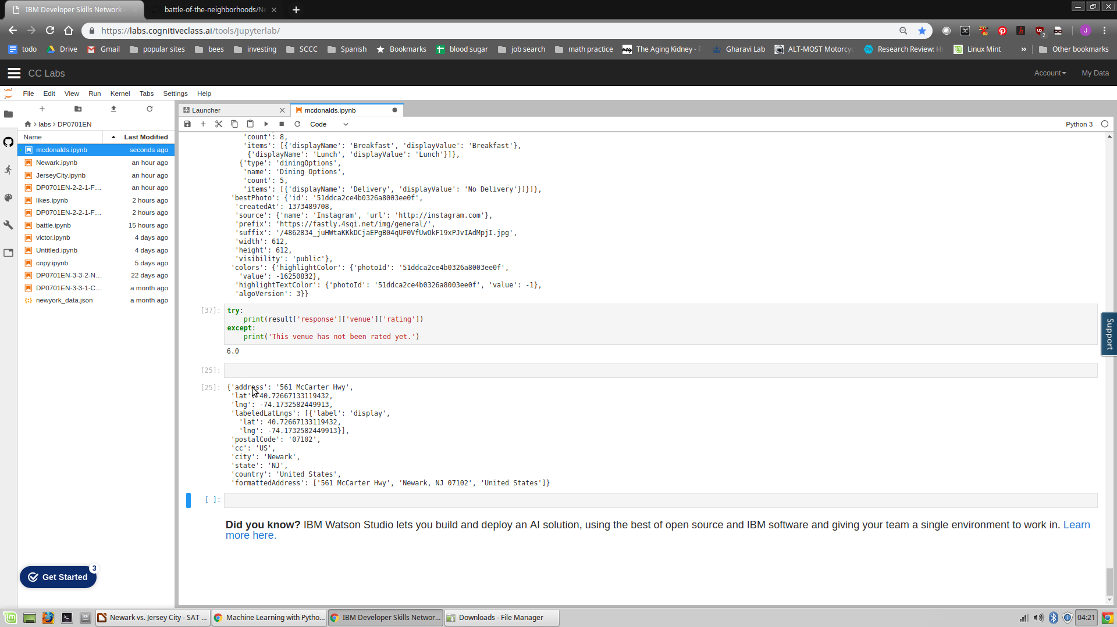
Found a mcdonalds with a 6.0
On 561 McCarter highway, so I will locate close to here!

